Slide 1
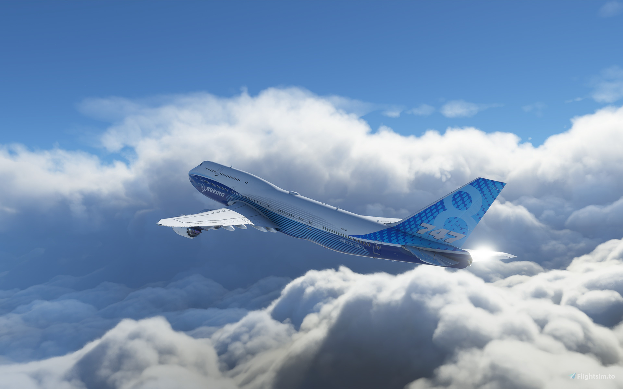
Predicting Airline Delays
Aris Grout
Wonho Choi

Slide 2
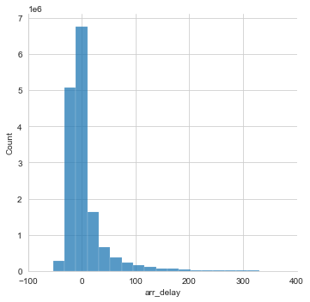
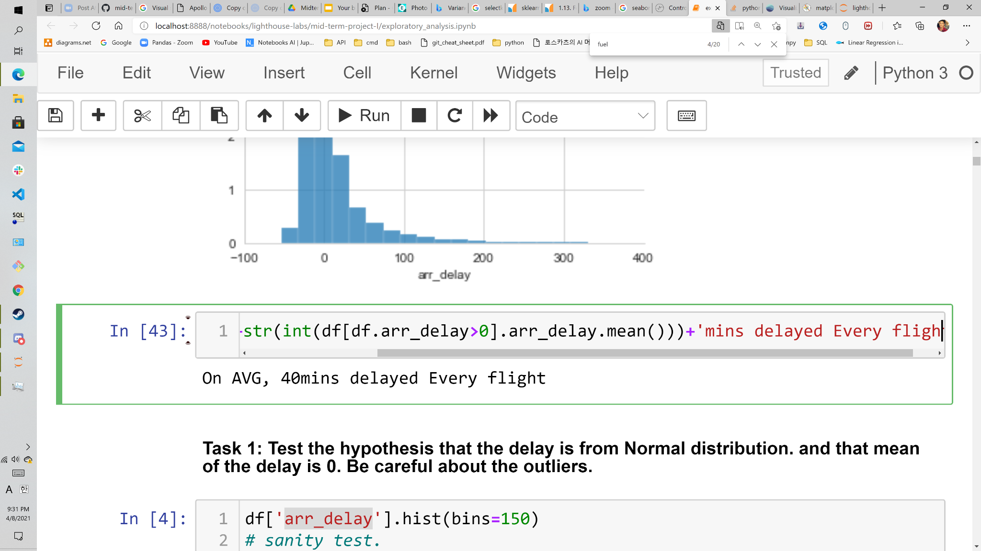
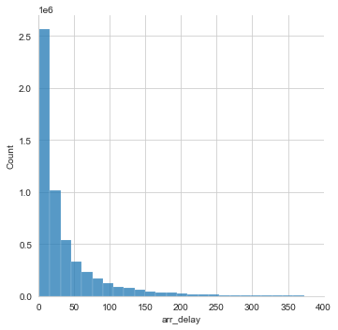
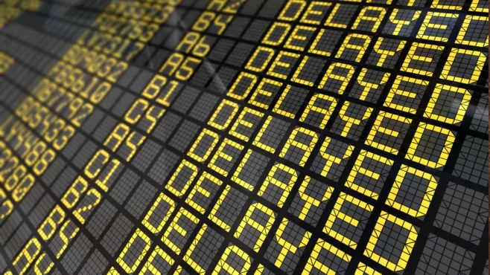
Problem: Inefficiency in Aviation
The cost: $33bill/2019 (in USA), ~ $74.24/min Trending upwards: +12.24%, +13.53%, +9.27%+ (in USA 2016-2019)

Slide 3



Highlight Tools
import pandas as pd
import sqlite3 as sqlite
from sklearn.feature_selection import VarianceThreshold
from sklearn.ensemble import RandomForestRegressor
from sklearn.model_selection import GridSearchCV
Visual Studio Code

Slide 4
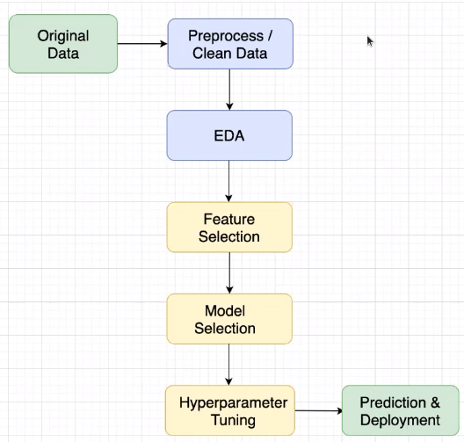

What was our
Process
of Machine Learning?
R2: 0.1713523428871443
ML Workflow

Slide 5
What ML Models/features does it take to Predict Flight delays?
ElasticNet, LinearRegr, XGboost,
RandomForestRegr, SGDRegr, …
['crs_dep_time(mins)', 'crs_arr_time(mins)', 'crs_elapsed_time', 'distance', 'origin_traffic', 'dest_traffic', 'origin_taxi', 'dest_taxi', 'WN', 'UA', 'F9', 'AS', 'DL', 'VX', 'NK', 'G4', 'AA', 'B6', 'HA', 'Monday', 'Tuesday', 'Thursday', 'Saturday', 'Wednesday', 'Friday', 'Sunday', '*Jan', 'dep_hr', 'arr_hr', 'o_tempC', 'o_windspeedKmph', 'o_winddirDegree', 'o_WindGustKmph', 'o_visibility', 'o_visibilityMiles', 'o_cloudcover', 'o_pressure', 'o_humidity', 'o_precipMM', 'o_totalSnow_cm', 'o_sunrise', 'o_sunset', 'd_tempC', 'd_windspeedKmph', 'd_winddirDegree', 'd_WindGustKmph', 'd_visibility', 'd_visibilityMiles', 'd_cloudcover', 'd_pressure', 'd_humidity', 'd_precipMM', 'd_totalSnow_cm', 'd_sunrise', 'd_sunset']
Most predictive features:
1. Weather (at Destination)
2. Day of week & traffic (Saturdays)
3. Air Carriers (good ol’ Delta Airlines)

Slide 6

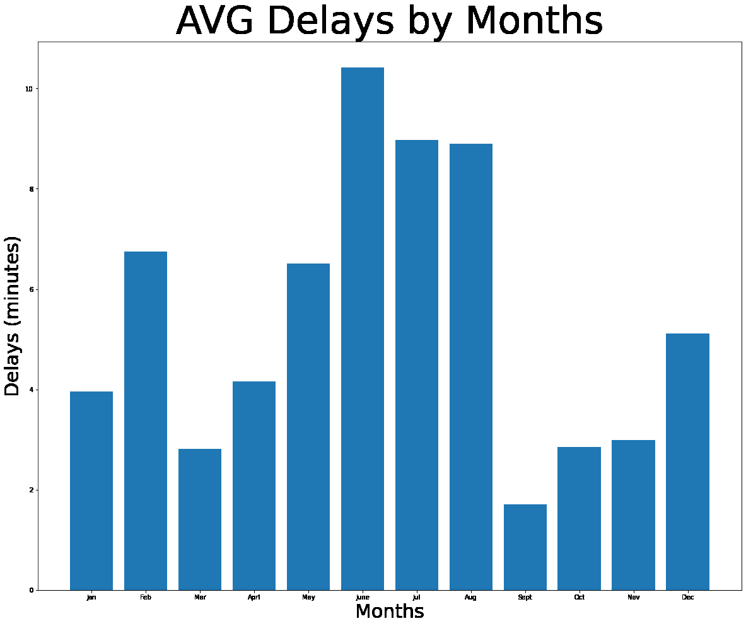
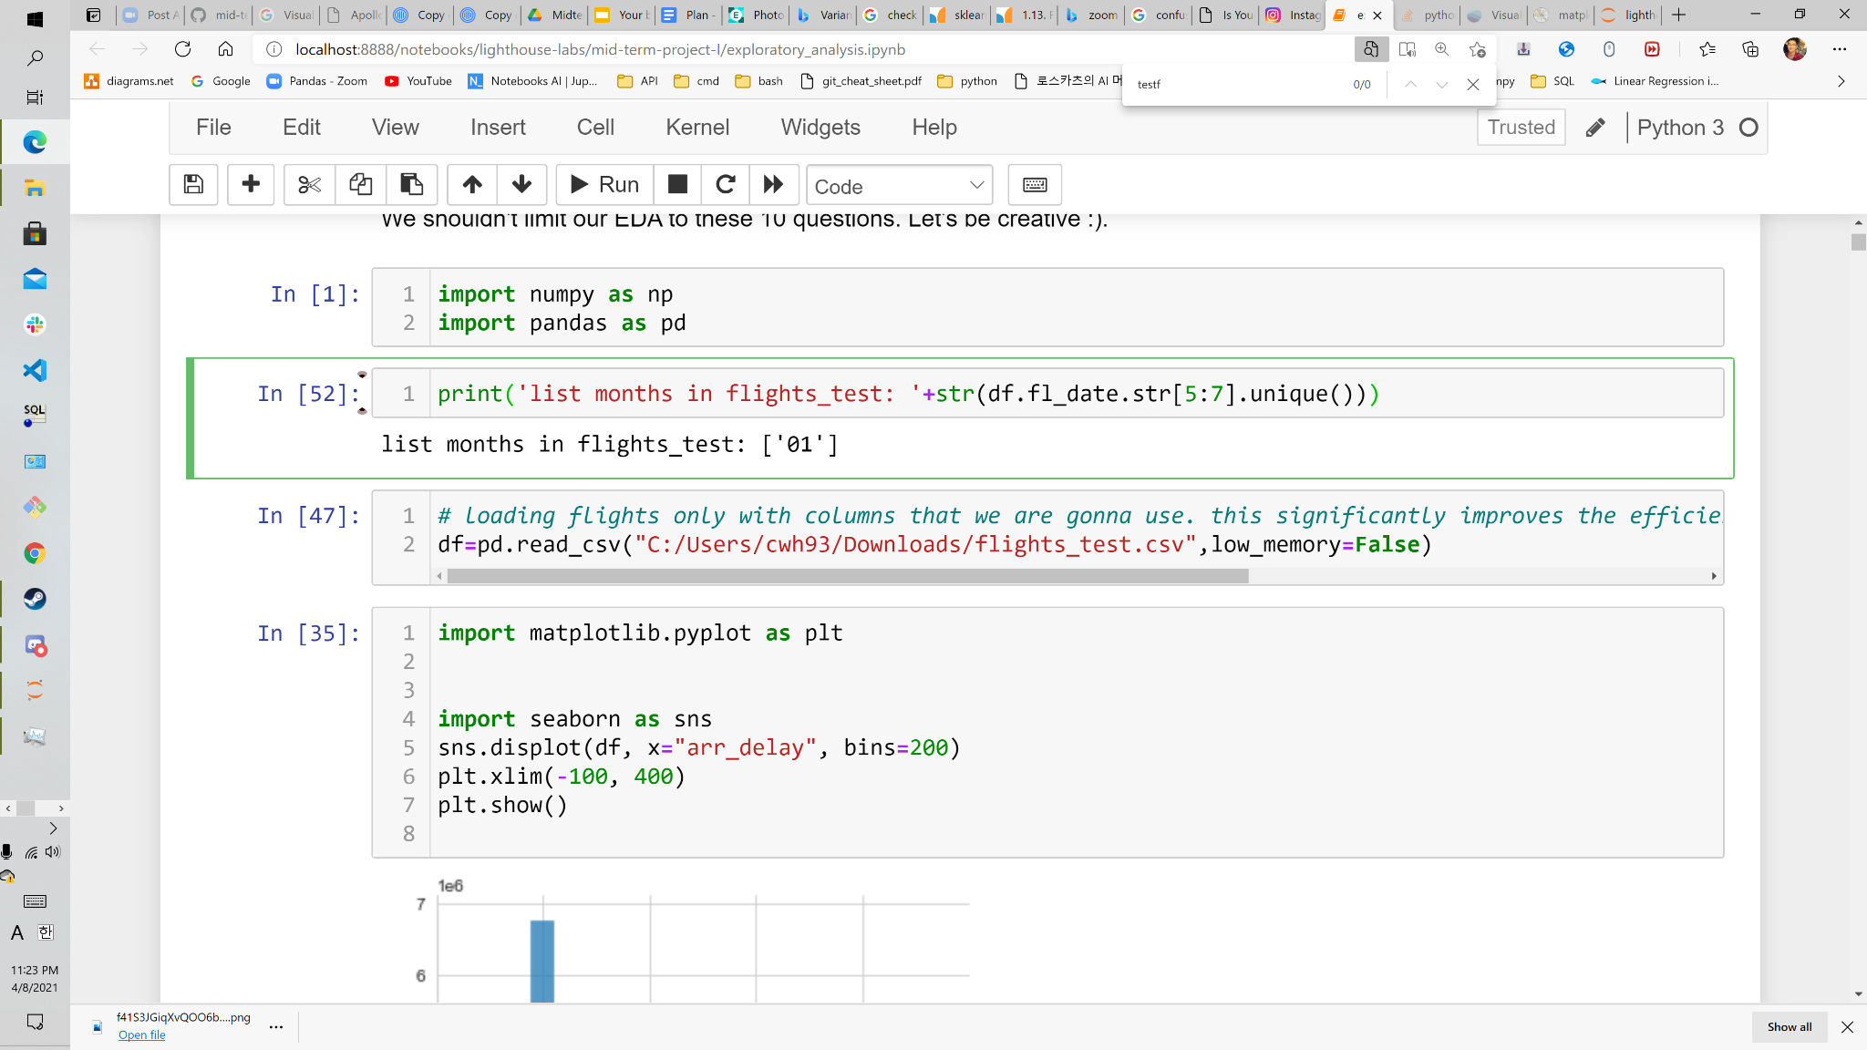
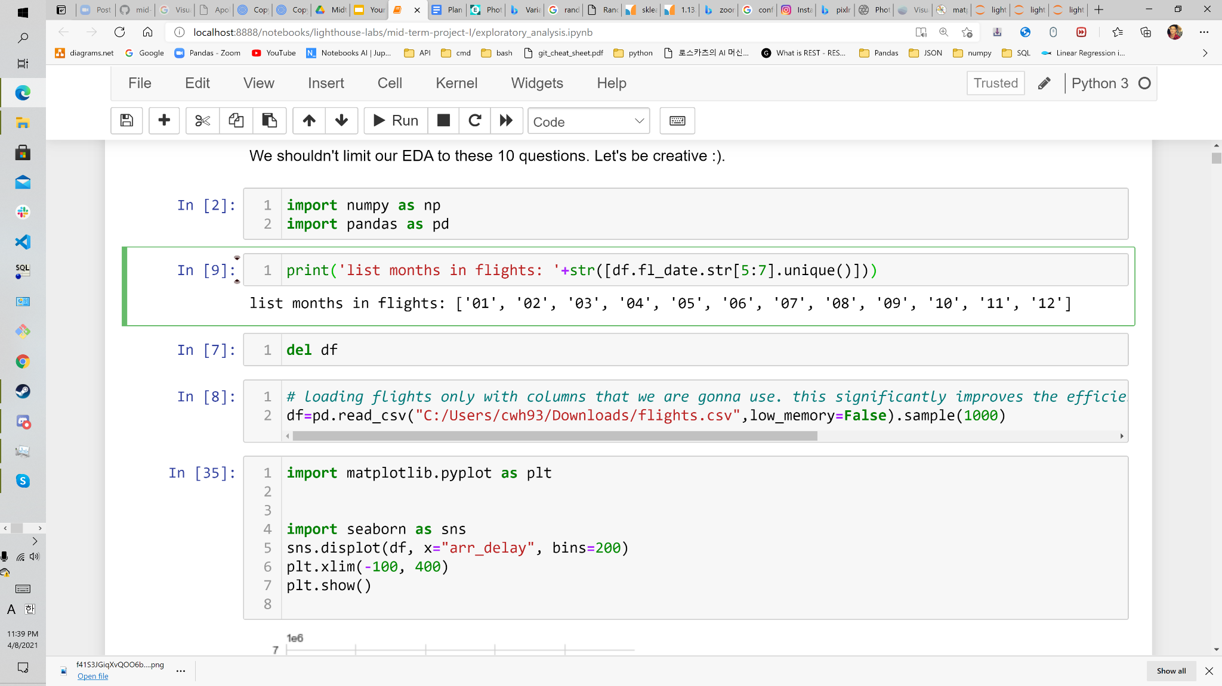
Check the calendar!

Slide 7
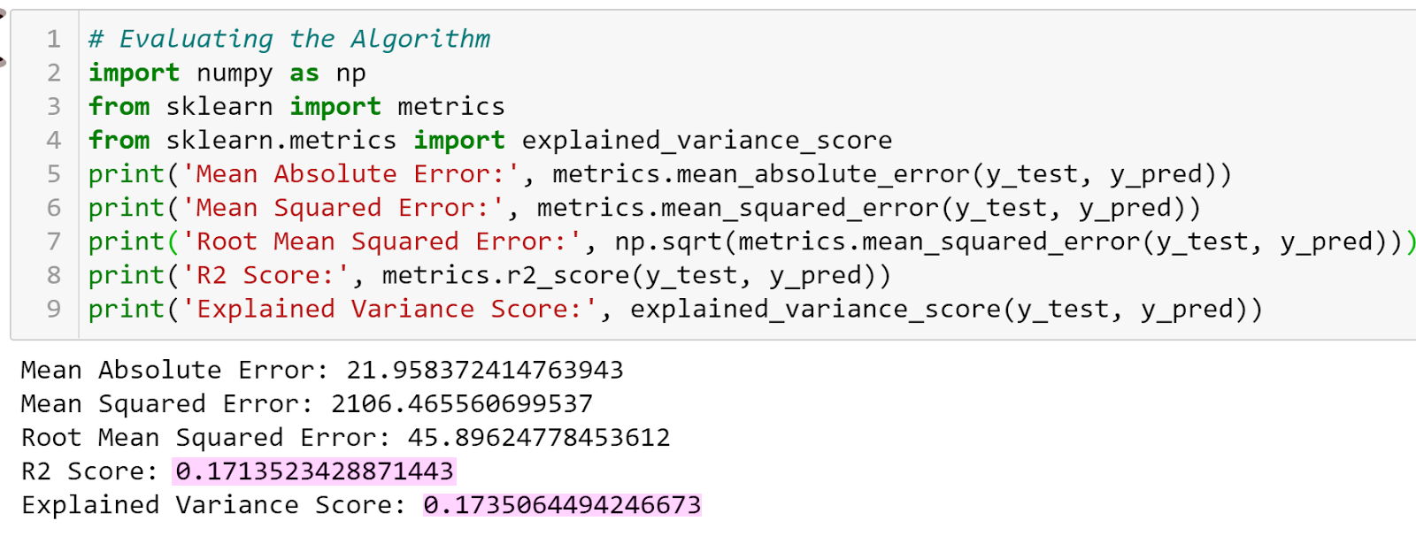
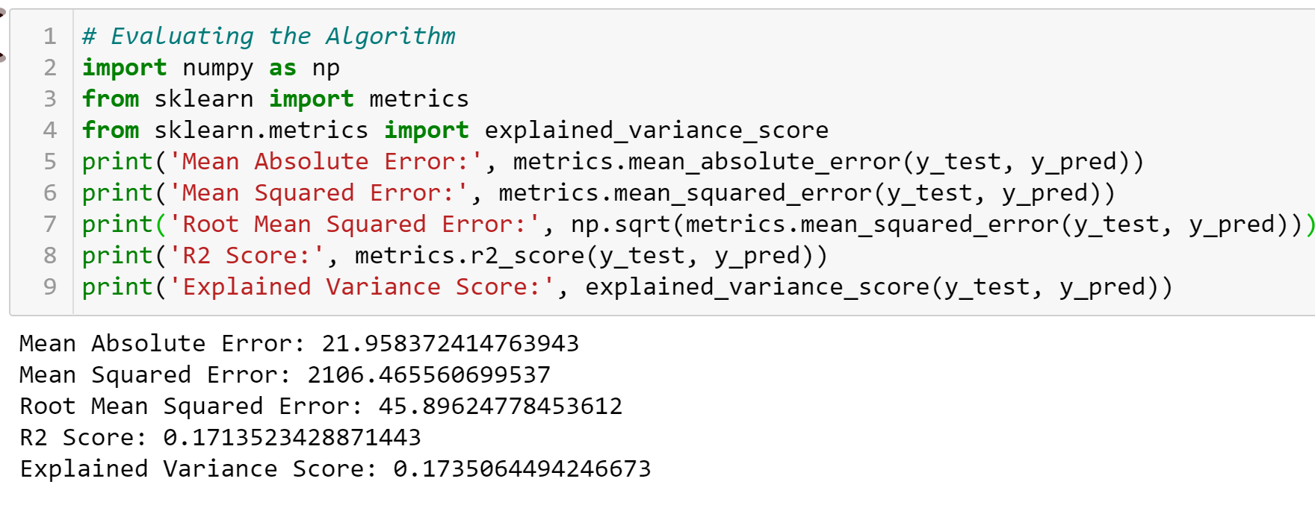
RandomForestRegr

Slide 8
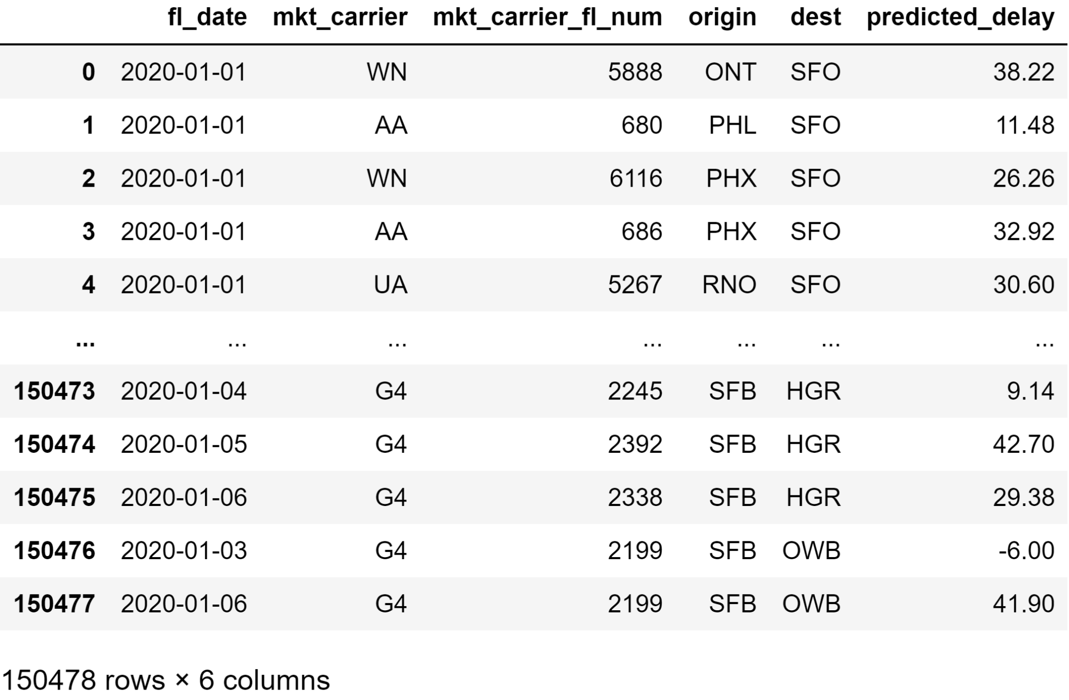

Slide 9
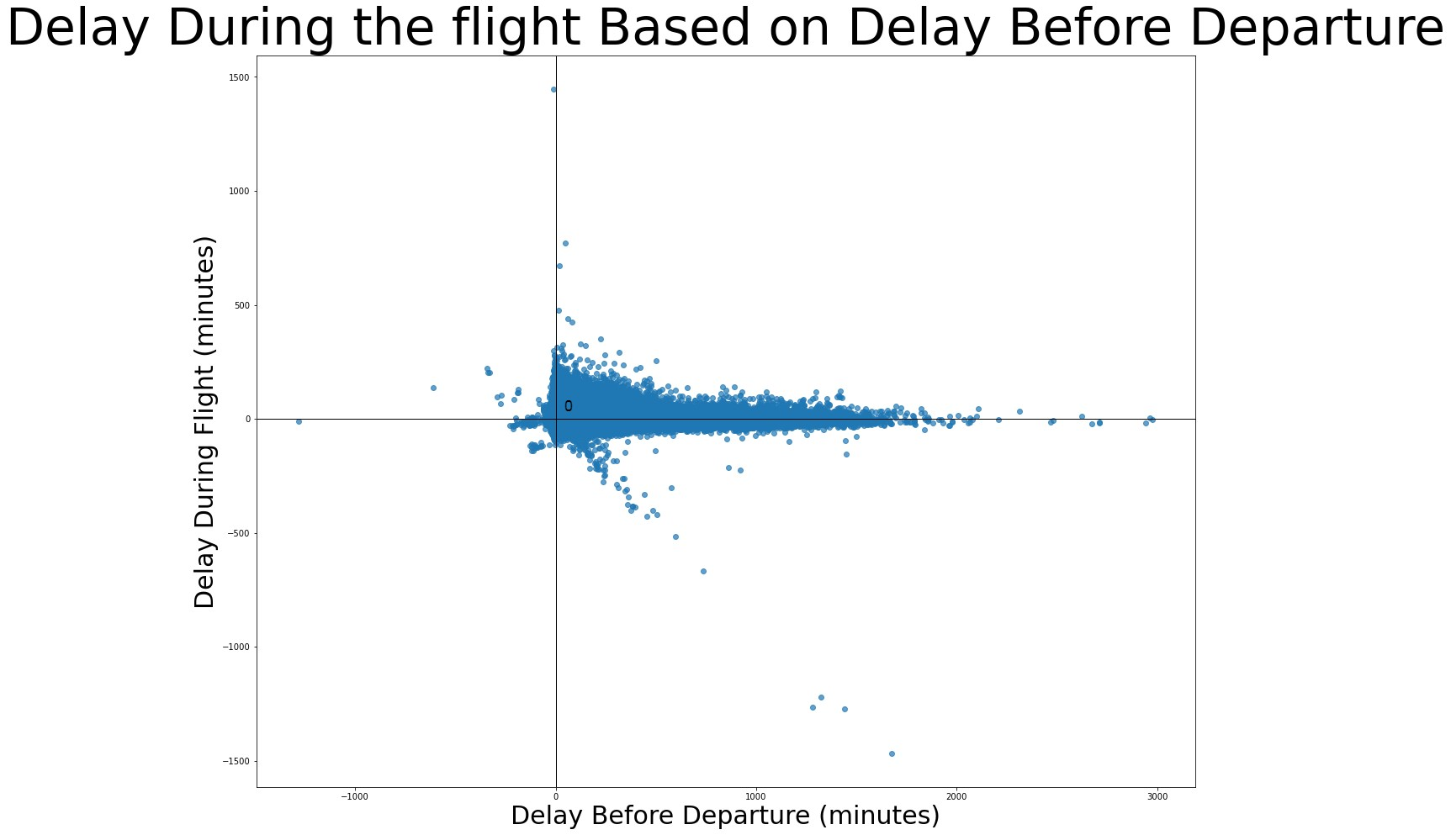
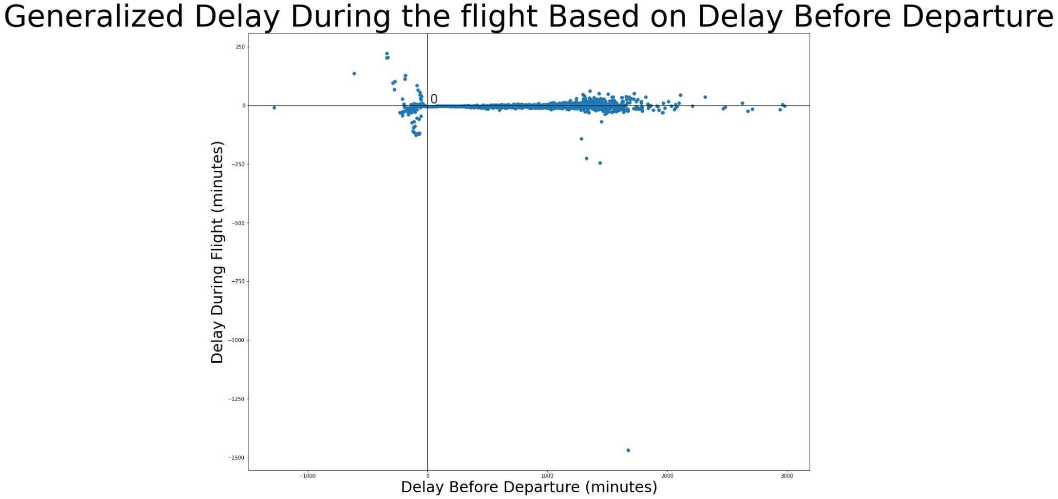
But the problem is:
On average, Delays that is already created before departure is 193.25% of Arrival delay(Total delay).
This clearly suggests that arrival delays are caused by departure delays.
And they try to reduce it during the flight

Slide 10

It’s more complicated!
'arr_delay'='Carrier_delay'+'weather_delay'+
'nas_delay'+'security_delay'+'late_aircraft_delay'
? ? ?

Slide 11
References
USA hourly delay costs https://www.airlines.org/dataset/per-minute-cost-of-delays-to-u-s-airlines/#
USA yearly costs
https://www.faa.gov/data_research/aviation_data_statistics/media/cost_delay_estimates.pdf

